Slide 1
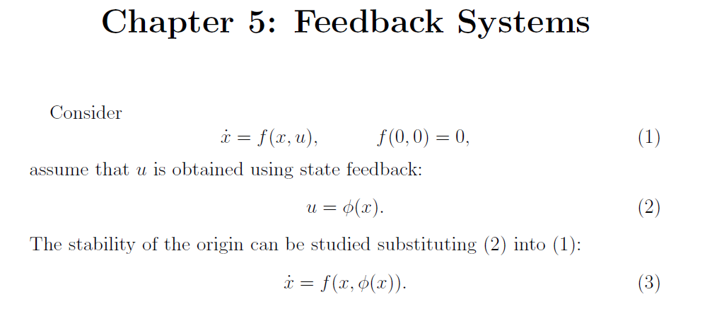
u
f(x,u)
x
f(x, φ(x)
x
φ(x)

Slide 2
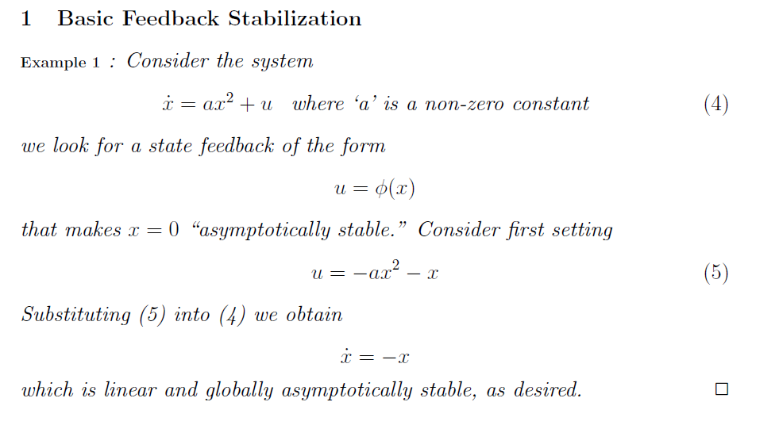

Slide 3
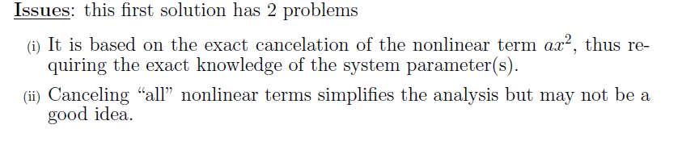

Slide 4
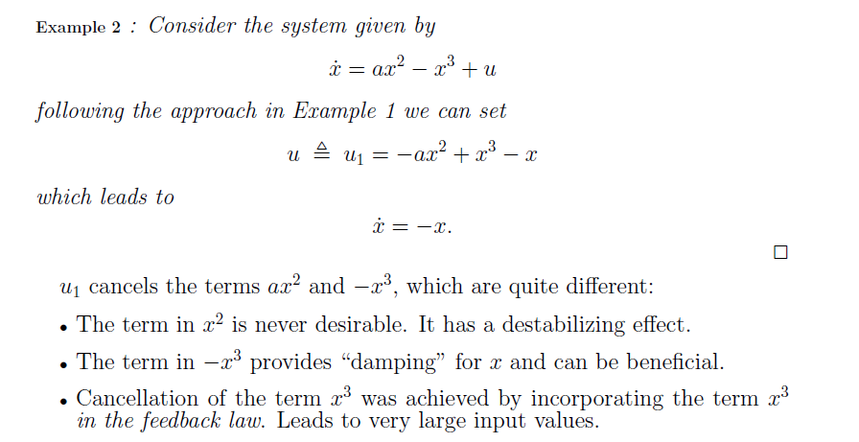

Slide 5
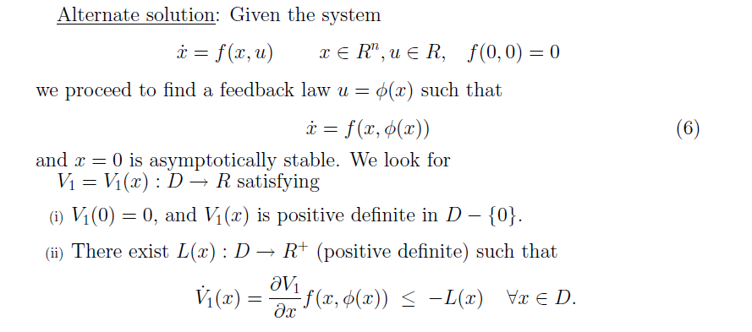

Slide 6
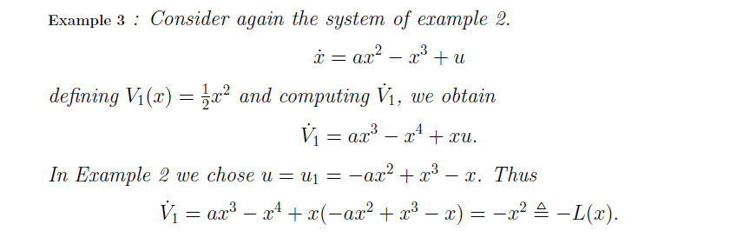
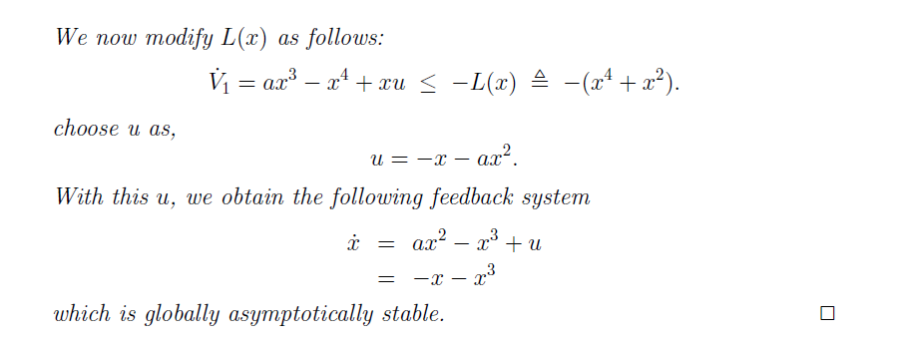

Slide 7
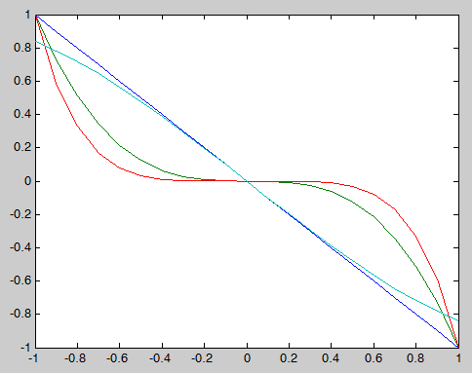
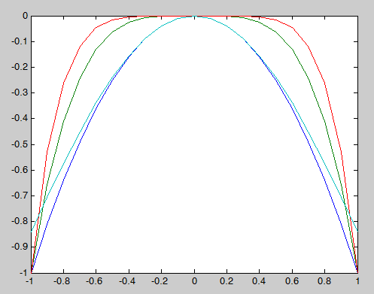
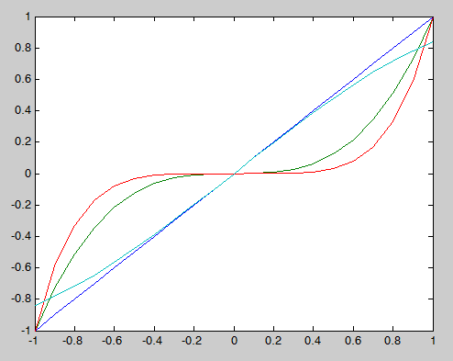
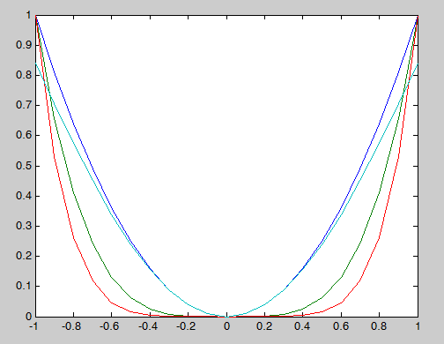
Example: Using feed-forward, what should be canceled?

Slide 8
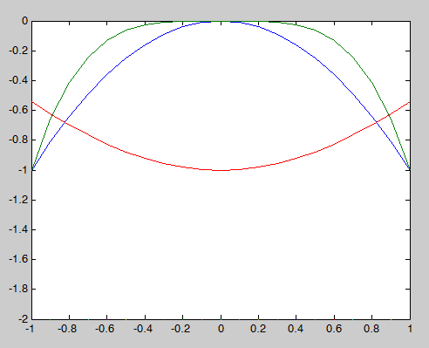
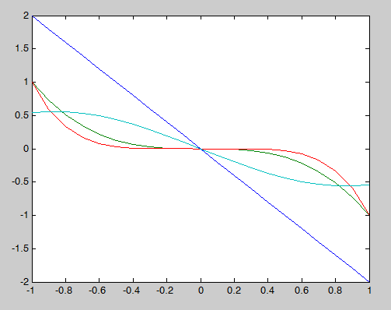
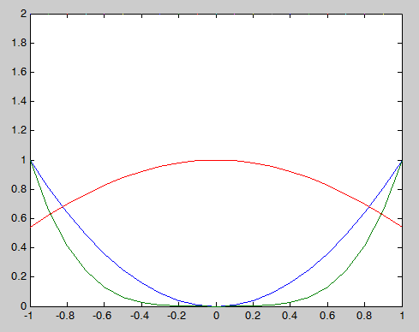
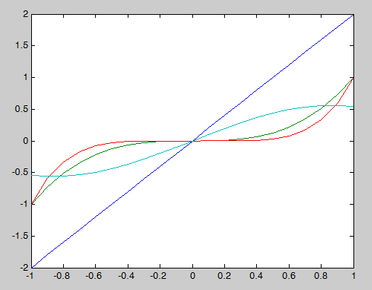
Example: Using feed-forward, what should be canceled?

Slide 9
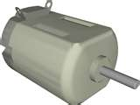
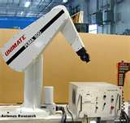
Example System: Electric Motor
Each link is basically a brushed DC motor with a pendulum load

Slide 10
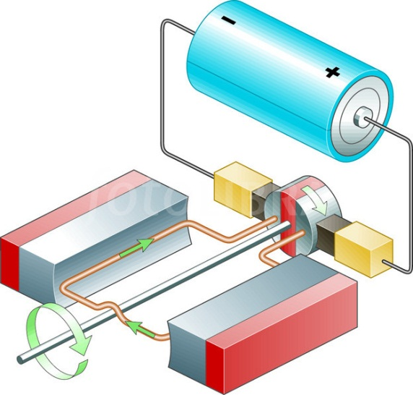
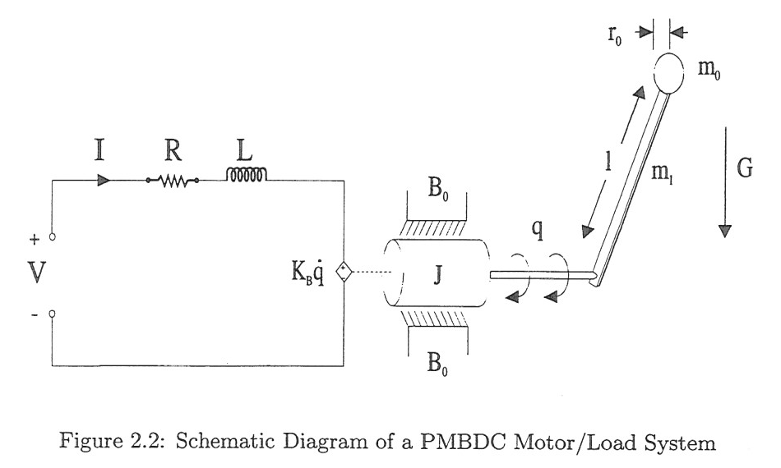
Motivating Example: Brushed DC Motor
Overview
Apply voltage
Produces current
Produces Torque
Rotates Mechanical Link
q(t) is the angular load position
i(t) is the coil current
Torque
Mechanical Subsystem
(Pendulum-like arm)
Electrical Subsystem (Motor Winding)

Slide 11

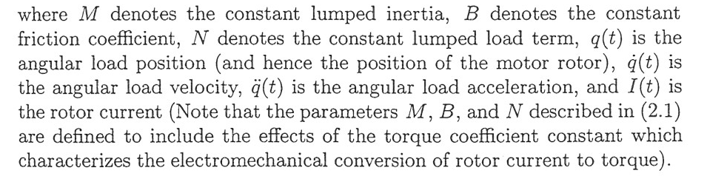

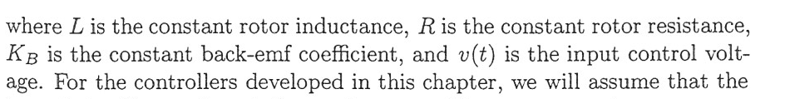
Motivating Example: Brushed DC Motor
Mechanical subsystem
Electrical subsystem
Connection between subsystems

Slide 12
Motivating Example: Brushed DC Motor
Traditional velocity control design using feedback linearization considering only the mechanical dynamics with an inertial load, like a wheel or fan (not a pendulum, N=0 in general model)
Design control using Lyapunov analysis tools to drive speed to zero
Propose a quadratic Lyapunov function
(could use any function that works with our Theorems)
M just to simplify the algebra (but it does affect the control)
Note that the motor would actually slow to zero even if there is no torque (control) input

Slide 13
Motivating Example: Brushed DC Motor
Design control to drive same system to a non-zero speed P (P is the desired speed) using a change of variables

Slide 14
Motivating Example: Brushed DC Motor
Position control of the motor with robotic load but ignoring the electrical dynamics
State space form
Torque indirectly affects the position x₁
Problem: need -x₁² here
Address this using Integrator Backstepping

Slide 15
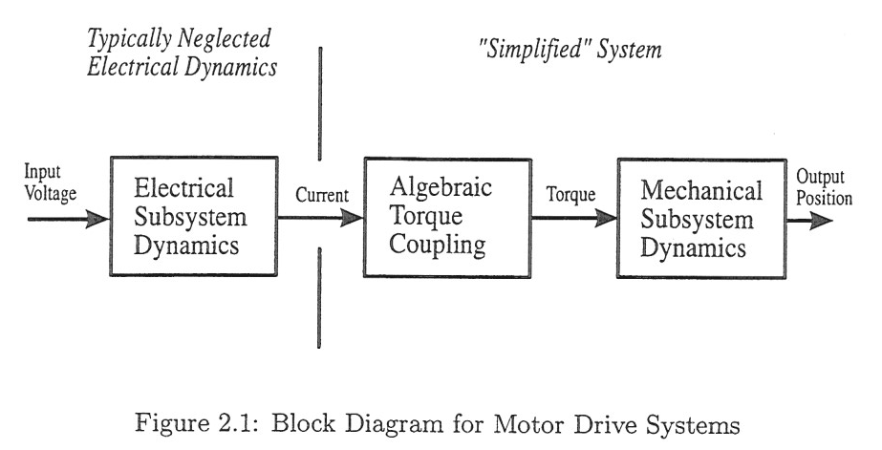
Motivating Example: Brushed DC Motor
Address this using Integrator Backstepping

Slide 16
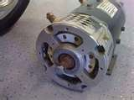
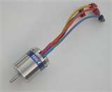
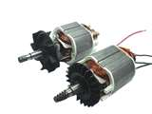
Motivating Example: Brushed DC Motor
Most electric motors fit into this same framework such as brushless DC, wound field DC, AC, stepper motor, induction motor
Complication is that the other motor types have multiple windings (phases)
An electronic or mechanical commutation is required to switch between phases to produce torque

Slide 17
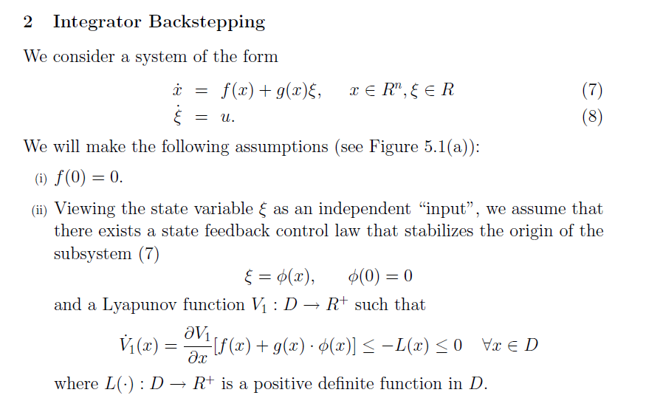
Consider
this first
Notes:
Zai (or sai)

Slide 18
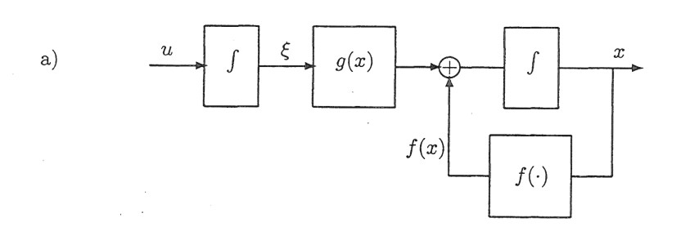
Original System

Slide 19
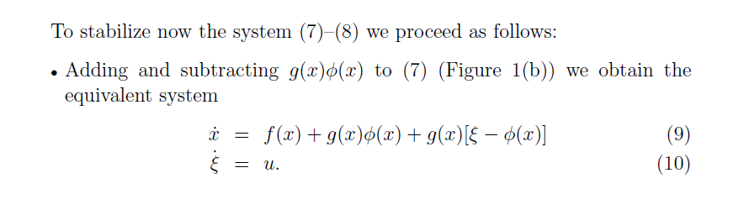
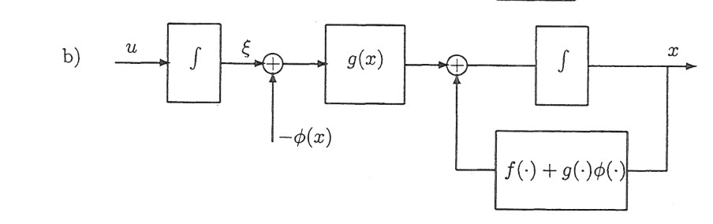
5
i.e. add zero to (7)
System after adding and subtracting

Slide 20
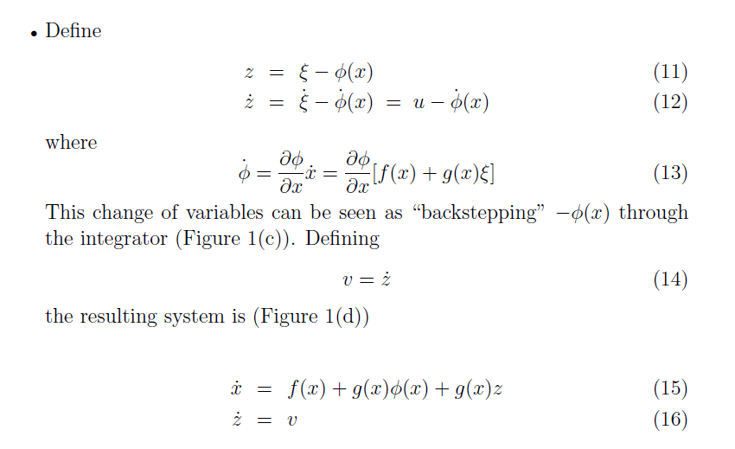
Change of variables:

Slide 21
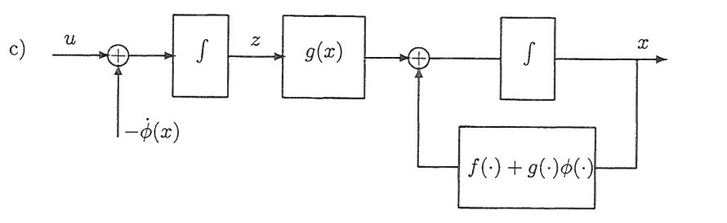
Change of variables:
You can think of this new variable as the error between the ϕ(x) that you would like to apply and the ξ that actually is applied, i.e. a tracking error

Slide 22
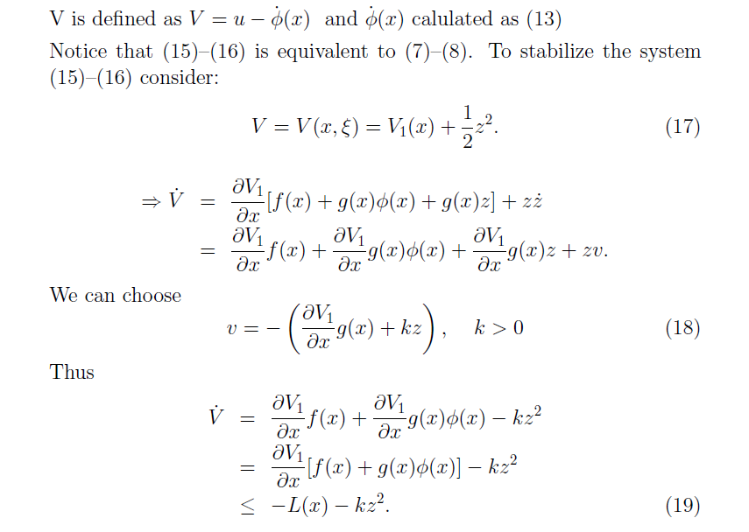
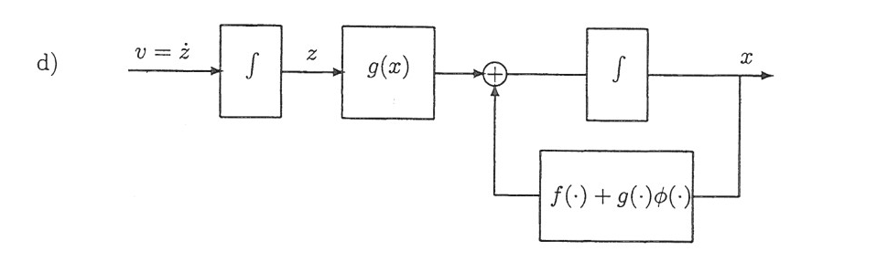
Recall:
No control input in (15)
v
v
Now design v to stabilize the system (with states z, x)

Slide 23
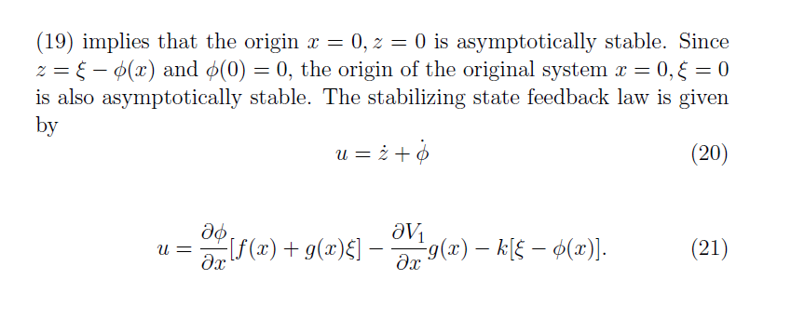
(7)
(8)
We have embedded the problem that we said we could solve (first-order system)
The transformed system (with states z,x) is now stabilized; however, v is not the input to our real system (can’t apply v to our system)

Slide 24
Derivative of the control for the first subsystem
This is now a formula for solving the problem of the specific form given in (7) and (8)

Slide 25
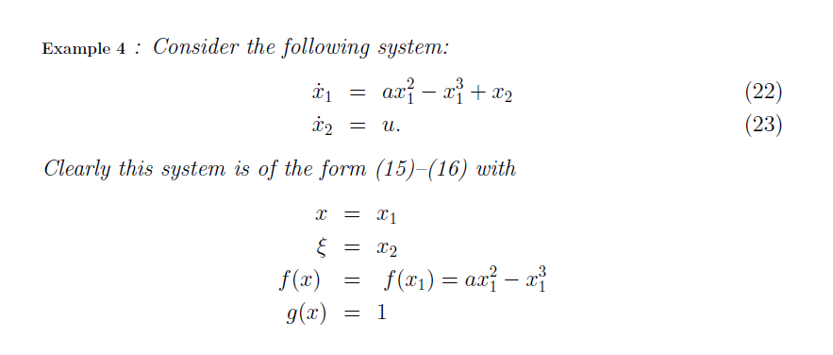

Slide 26
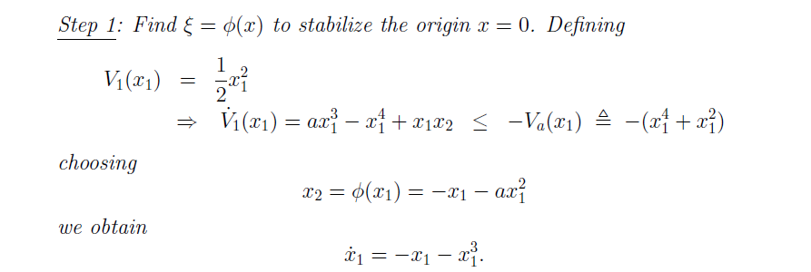
We already solved a similar problem in Example 1:
We are embedding the control design approach, “Basic Feedback Linearization”, into the Integrator Backstepping. Other control design techniques could be used here.

Slide 27
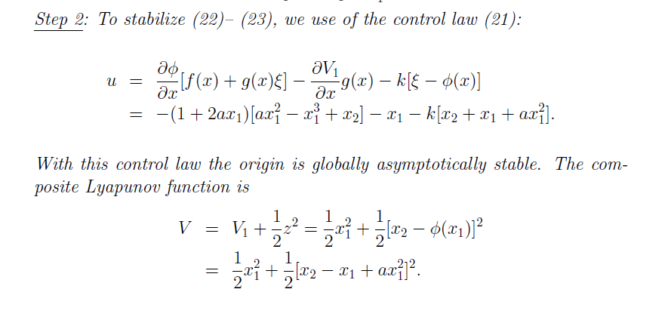
Formula for u
Formula for V
PD? Yes
Radially Unbounded? yes

Slide 28
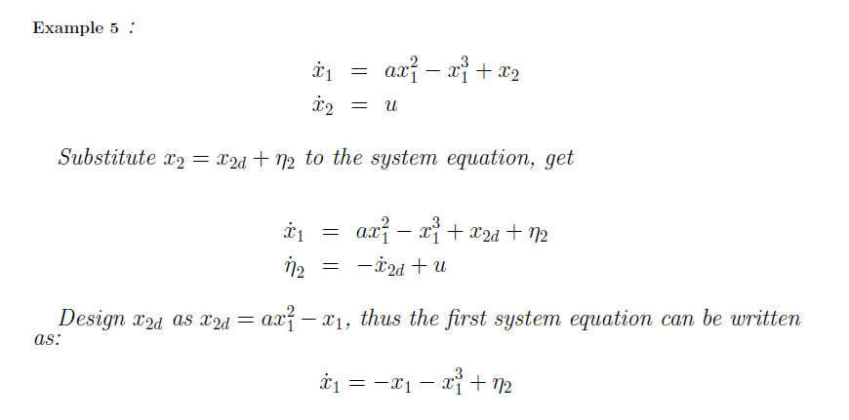
Alternate Solution to Example 4 (Handcrafted Backstepping)
Motivated by tracking error:
Desired trajectory that we can specify to control x₁
Error between actual trajectory x₂ and the desired trajectory
-
(See Example 4)
To this point: We have stabilized x₁ if we know that the tracking error η₂ goes to zero. Must now work with the input u to make certain that η₂ goes to zero.

Slide 29
Alternate Solution to Example 4 (Handcrafted Backstepping)

Slide 30
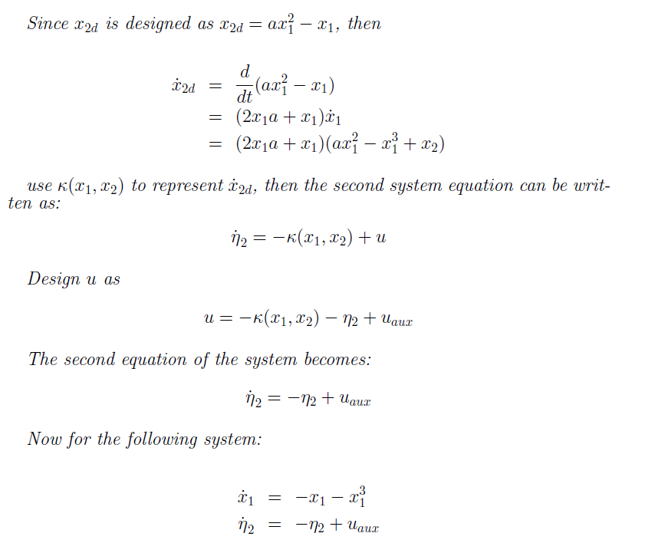
Alternate Solution to Example 4 (Handcrafted Backstepping)
-
=
-
+
1
1
-
+
Note: This is a dynamic system that describes the tracking error - we want to prove that the state of this system will to go to zero (is stable at zero) just like the systems we analyzed in Chapters 3.
Stabilizing term
Additional requirements in the composite Lyapunov analysis

Slide 31
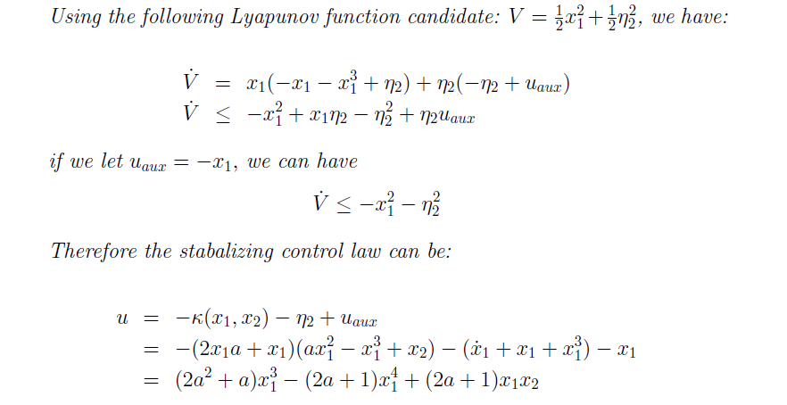
Alternate Solution to Example 4 (Handcrafted Backstepping)
Could not remove this interconnection term earlier because it allowed us to introduce x_{2d} into the x₁ dynamics.
1
(same result as Example 4 with k=1)

Slide 32
Alternate Solution to Example 4 (Handcrafted Backstepping)

Slide 33
We have solved the backstepping problem for a specific class of systems:
No other terms but u
Scalar
Showed a general approach that provides formulas for u and V
Showed a handcrafted approach.

Slide 34
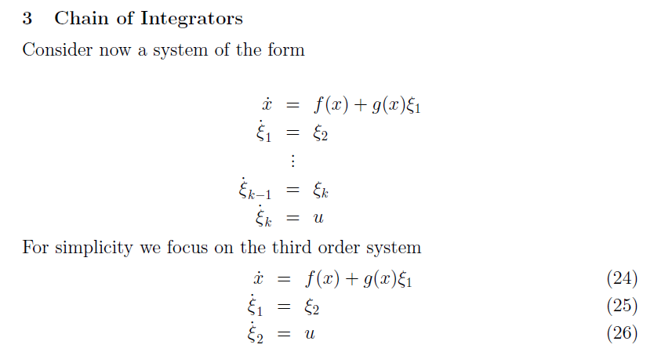

Slide 35
Solution of the more complicated problem in this form can be solved as a recursion of the simple solution (one coupled subsystem)
Must now apply the control through 2 subsystems

Slide 36
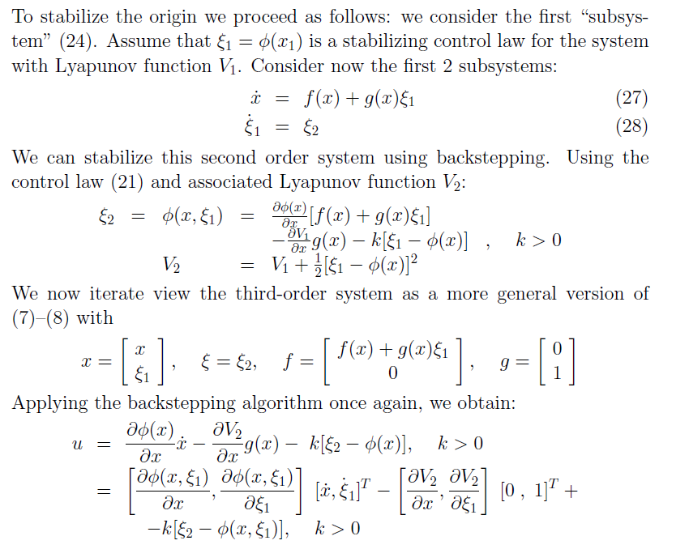

Slide 37
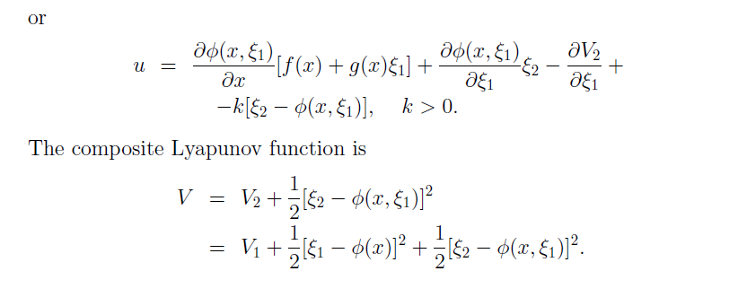

Slide 38
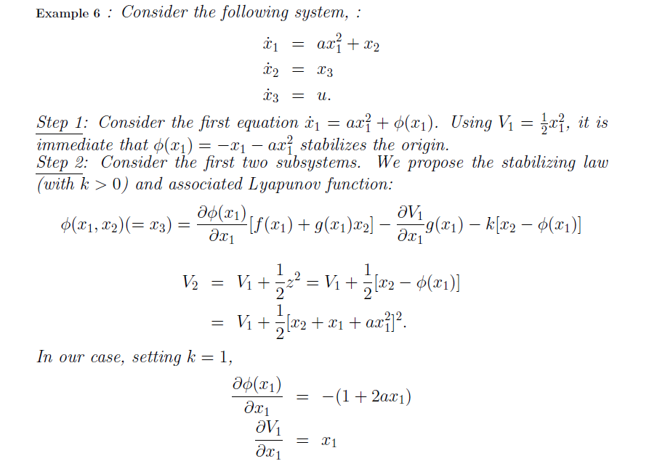

Slide 39
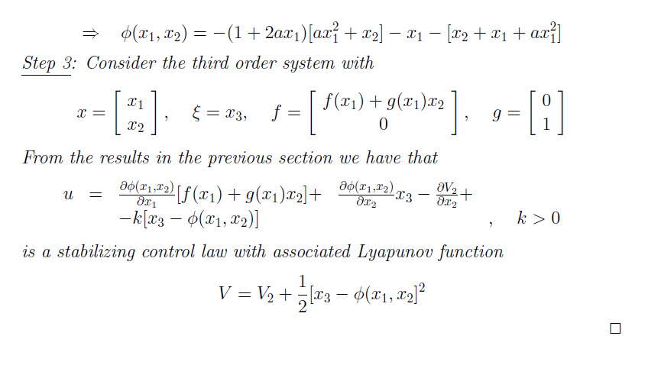
Homework K part 1: Find u and evaluate V

Slide 40
Alternate Solution to Example 6 (Handcrafted Backstepping)

Slide 41
Alternate Solution to Example 6 (Handcrafted Backstepping) -cont

Slide 42
Alternate Solution to Example 6 (Handcrafted Backstepping) -cont

Slide 43
Alternate Solution to Example 6 (Handcrafted Backstepping) -cont

Slide 44
Alternate Solution to Example 6 (Handcrafted Backstepping) -cont
Control design
Operation of Control

Slide 45
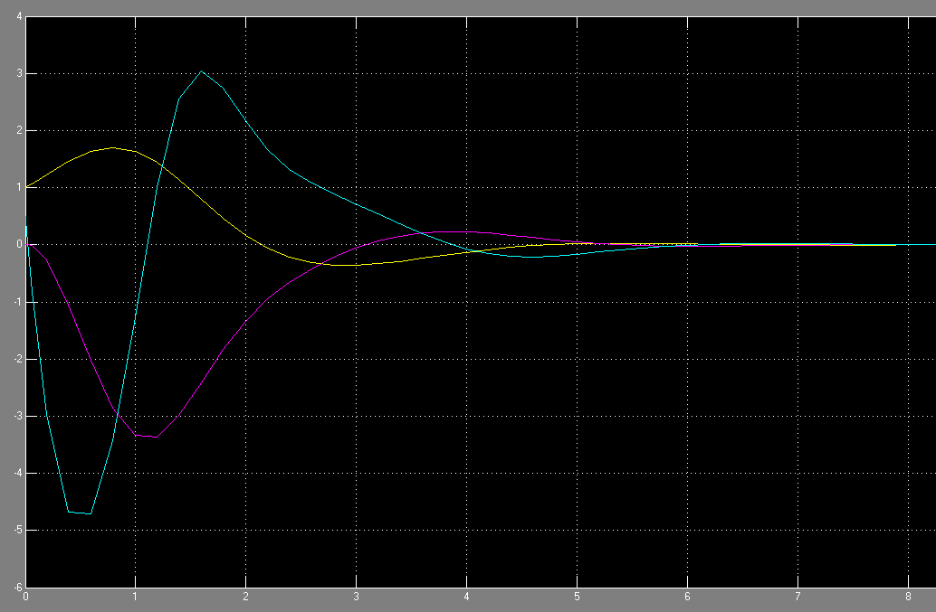
Alternate Solution to Example 6 (Handcrafted Backstepping) - Simulation
x1
x3
x2

Slide 46
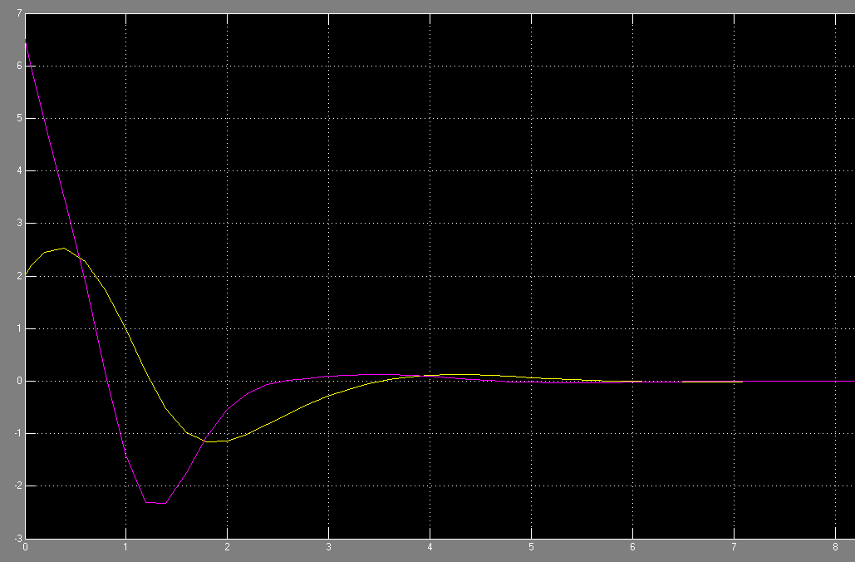
Alternate Solution to Example 6 (Handcrafted Backstepping) - Simulation
Eta 3
Eta 2

Slide 47
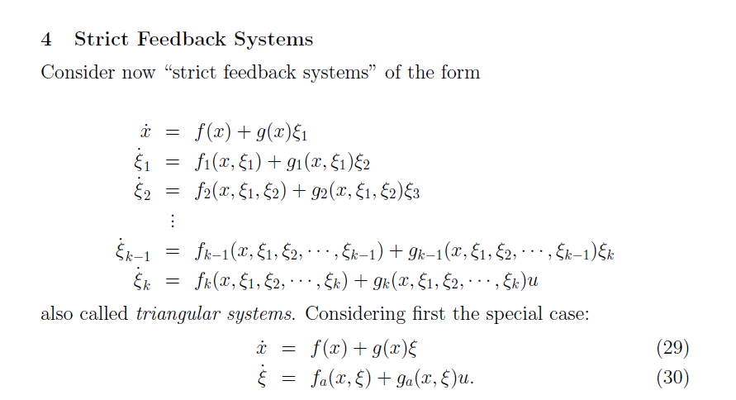
If g(x)=0 the system is not controllable
Electric Motor
Mechanical Dynamics
Electrical Dynamics

Slide 48
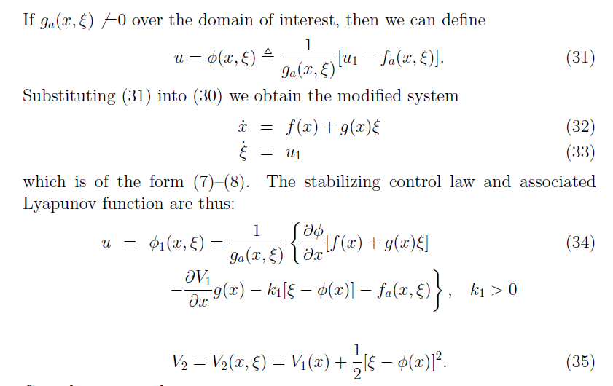

Slide 49
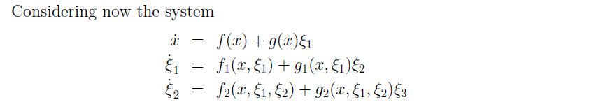


Slide 50

Control goes to constant as we reach x₁=0
?

Slide 51
Alternate Solution to Example 7 (Handcrafted Backstepping)
Note: Design control assuming full-state feedback and exact model knowledge
Statement of control problem: make x₁ go to zero and have all other signals remain bounded

Slide 52
Alternate Solution to Example 7 (Handcrafted Backstepping) - cont

Slide 53
Alternate Solution to Example 7 (Handcrafted Backstepping) - cont
Statement of control problem: make x₁ go to zero and have all other signals remain bounded

Slide 54
Summary of Chapter 5
Stabilizing the origin.
Used Lyapunov analysis to drive the design of the control u for the nonlinear system:
Single input
Used integrator backstepping to design a generalized controller for three general cases:
1) Single Integrator:
Depending on the system type and complexity, a handcrafted backstepping approach may possible.
This approach will be helpful later when designing other controllers, e.g. an adaptive controller.
2) Chain of Integrators:
3) Strict Feedback Systems:
Stabilizing to other points requires shift of the system.

Slide 55
Summary of Chapter 5
Categorizing a System into One of the three General Backstepping Forms
Backstepping a signal through a dynamic system adds to the complexity of the control design.
First goal is to identify the largest block that would be controllable with a single input from the remaining subsystems.
The list of equations may be rearranged as needed.
Single input controllable system (not a backstepping problem)
Second, identify the format of the remaining equations
1) Single Integrator:
3) Strict Feedback Systems:
2) Chain of Integrators:
3) Strict Feedback Systems:
Note that cases 1) and 2) are just a simplified subset of 3), i.e. 3) always works but will require more work.

Slide 56
Examples of Categorizing Systems
Example 1
Not a backstepping problem
Example 2
Not useful
1) Single Integrator:

Slide 57
Homework 5.0
5.01 Design a controller u for the system below to stabilize the origin. Use Simulink to simulate the states, control law, Lyapunov function and its derivative
5.02 Design a controller u for the system below to stabilize the origin. Use Simulink to simulate the states, control law, Lyapunov function and its derivative)

Slide 58



Homework 5.0 (sol)
5.01 (solution)
Note on Simulink:
(0.8658) is an equilibrium point if u=0
Response to (.1)

Slide 59


Homework 5.0 (sol)
5.01 (solution)

Slide 60
Homework 5.0 (sol)
5.01 (solution)

Slide 61


u=0
Response to (.1)
5.02 (solution)
Simulation of the plant:

Slide 62


Homework 5.0 (sol)
5.02 (solution)

Slide 63


Slide 64
Homework 5.1
Marquez Problem 5.1 (Use Simulink to simulate the states, control law, Lyapunov function and its derivative)
(5.1 HC) Repeat Marquez 5.1 using a handcrafted backstepping controller for
5.1.b) Src:TCB
Design a controller (without using backstepping) to stabilize the origin of the following system
Only have 1 input and two states, may not be able to solve this control problem in general
5.1c) Src:TCB
Design a controller (using backstepping) to stabilize the origin of the following system

Slide 65

Homework 5.1 (sol)
Solution

Slide 66
Homework 5.1 (sol)
(5.1) solution (cont)

Slide 67


Homework 5.1 (sol)
(5.1) solution (cont)
Response to (.1,0)

Slide 68
Homework 5.1 (sol)
(5.1 HC) Design a handcrafted backstepping controller for Marquez problem 5.1
Inject a control term and following error into top equation (one without control input)
Find error dynamics
Lyapunov analysis
Could design part of u at this point
(we will wait until later here)

Slide 69
Homework 5.1 (sol)
(5.1 HC) Design a handcrafted backstepping controller for Marquez problem 5.1
Same as previous backstepping result

Slide 70
Homework 5.1 (sol)
5.1.b) Src:TCB
Design a controller (without using backstepping) to stabilize the origin of the following system
Only have 1 input and two states, may not be able to solve this control problem in general

Slide 71
Homework 5.1
5.1.c) Src:TCB
Design a controller (using backstepping) to stabilize the origin of the following system

Slide 72
Homework 5.1 (sol)
5.1.c) Src:TCB
Design a controller using backstepping to stabilize the origin of the following system
Show all signals remain bounded

Slide 73
Homework 5.2
Problems 5.2, Also solve 5.2 using a handcrafted backstepping solution, 5.3

Slide 74
Homework 5.2
Prey-Predator System (normalized system)
Prey dynamics
Predator dynamics
Find u
Reduce population of prey to zero
by +/- predators (a=1, b=0.5)

Slide 75


Homework 5.2 (sol)

Slide 76
Homework 5.2 (sol)

Slide 77
Homework 5.2 (sol)

Slide 78
Alternate Solution to Example 6 (Handcrafted Backstepping) -cont

Slide 79
Alternate Solution to Example 6 (Handcrafted Backstepping) -cont

Slide 80

Homework 5.2 (sol)
Errors
Cai si =x3
1

Slide 81
Homework 5.2 (sol)
Solution to the Predator Prey System

Slide 82


Homework 5.2 (sol)
Solution to the Predator Prey System
k₁=10

Slide 83



Homework 5.3
Solve Problems 5.4 using a handcrafted backstepping solution, simulate using Simulink
Need to configure a compiler. In MATLAB:
>mex –setup
> Would you like mex to locate installed compilers [y]/n? y
> [1] Lcc-win32 C 2.4.1 in C:\PROGRA~2\MATLAB\R2010a\sys\lcc
(Note you can also use a Microsoft Visual C++ Express, Windows 64 bit Matlab complicates things)
Solve 5.5 using a handcrafted backstepping solution

Slide 84
Homework 5.3 (sol)
Solve Problems 5.4 using a handcrafted backstepping solution

Slide 85
Homework 5.3 (sol)
Solve Problems 5.4 using a handcrafted backstepping solution

Slide 86
Homework 5.3 (sol)
Solve Problems 5.5 using a handcrafted backstepping solution

Slide 87
Homework 5.3 (sol)
Solve Problems 5.4 using a handcrafted backstepping solution

Slide 88
Homework 5.4
Using a handcrafted backstepping solution to ensure x₁=-1, simulate using Simulink

Slide 89
Homework 5.4 (sol)

Slide 90
Homework 5.4 (sol)

Slide 91
Homework 5.4 (sol)

Slide 92
Homework 5.4 (sol)

Slide 93
Homework 5.5

Slide 94
Homework 5.5 (sol)
Outline of solution
x₁
Want x₁ to go to zero
x₁ subsytem
SINCE we have exact model knowledge
of the x₁ subsystem,
IF we could directly specify x₂ we
Could Design x₂ as an exact model
knowledge controller
x₂
x₂ subsytem
Use backstepping to design x₂
u
UNKNOWN Constant Parameter in
x₂ subsytem -> design an
adaptive controller for u.

Slide 95
Homework 5.5 (sol)

Slide 96
Homework 5.5 (sol)

Slide 97
Homework 5.5 (sol)

Slide 98
Homework 5.6

Slide 99
Homework 5.6 (sol)
Outline of solution
x₁
Want x₁ to follow x_{d}
x₁ subsytem
SINCE we have exact model knowledge
of the x₁ subsystem,
IF we could directly specify x₂ we
Could Design x₂ as an exact model
Knowledge tracking controller
Same as previous problem
x₂
x₂ subsytem
Use backstepping to design x₂
u
UNKNOWN Constant Parameter in
x₂ subsytem -> design an
adaptive controller for u.
Same as previous problem

Slide 100
Homework 5.6 (sol)

Slide 101
Homework 5.6 (sol)

Slide 102
Homework 5.6 (sol)

Slide 103
Homework 5.7

Slide 104
Homework 5.7 (sol)

Slide 105
Homework 5.7 (sol)

Slide 106
Homework 5.7 (sol)

Slide 107
Homework 5.7 (sol)

Slide 108
Homework 5.7 (sol)

Slide 109
Homework 5.7 (sol)

Slide 110
Homework 5.7 (sol)

Slide 111
Homework 5.7 (sol)

Slide 112
Homework 5.7 (sol)

Slide 113
Old Test Problem

Slide 114
Old Test Problem (cont)

